Slide 1

Cheetah: A High-Speed Differentiable Beam Dynamics Simulation Code
Chenran Xu, Jan Kaiser, Annika Eichler and Andrea Santamaria Garcia

Slide 2
Outline
What is Cheetah?
What can you do with Cheetah?
What is the development plan?

Slide 3
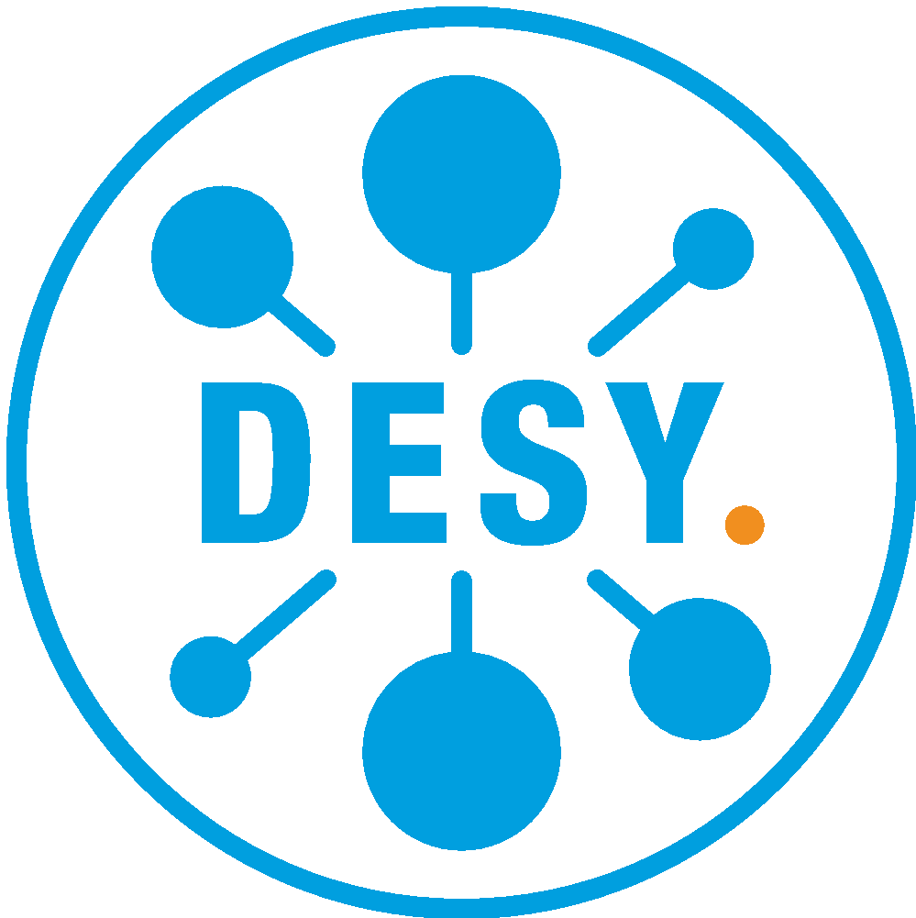



What is Cheetah?
Python package for beam dynamics simulation based on PyTorch for use with machine learning applications
Two main features in support of ML applications:
Ultra-fast compute: Cheetah can run order of magnitude faster than some other codes.
Differentiability: Based on PyTorch, Cheetah supports automatic differentiation for all its computations.
Incidentally, Cheetah provides full GPU support and integrates seamlessly with ML models built in PyTorch.
Designed to be easy to use and easy to extend.
We generally aim for high code quality!
Black / isort code formatting + flake8 conformity enforced.
Encourage proper procedures in GitHub repository (automatic tests / PR templates, good documentation etc.)

Slide 4
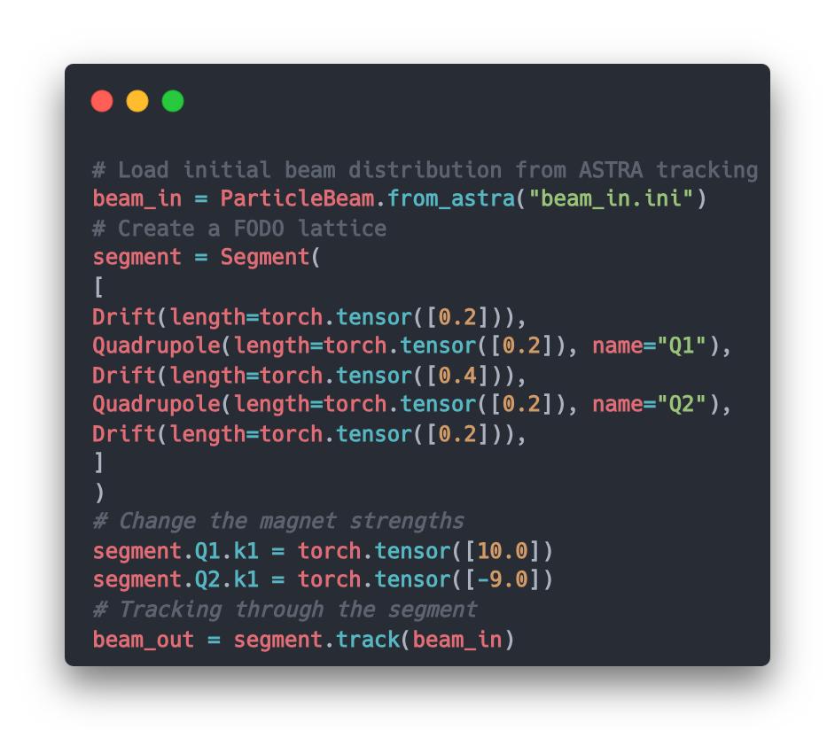
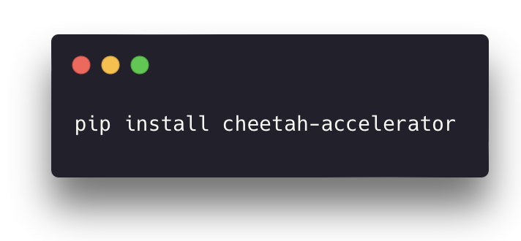
Simple installation and usage
Install simply as a python package:
Load an initial beam and start tracking
Open-source GitHub project
https://github.com/desy-ml/cheetah

Slide 5
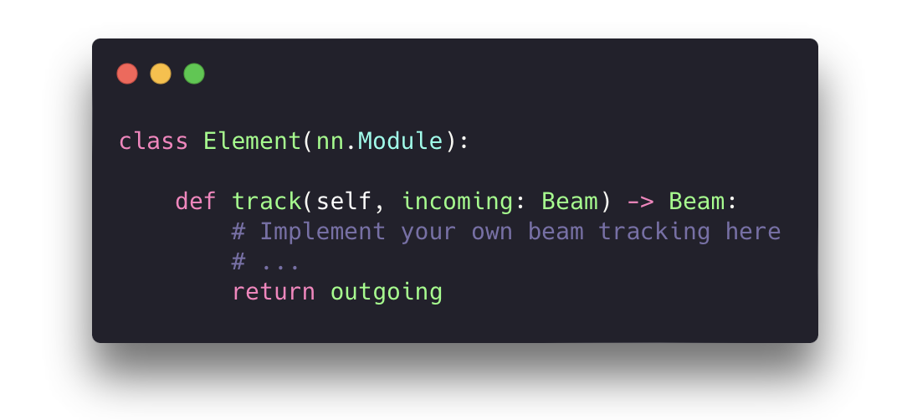
Basic Structure: Elements and Beams
Subclasses represent accelerator components like drifts, quadrupoles, dipoles etc.
Currently Cheetah supports 14 different element types
Special element Segment represents lattices (sequences) of elements.
Supports loading from LatticeJSON, Ocelot and Bmad
Each element contains a track method to track the incoming beam
Custom component can be easily implemented

Slide 6
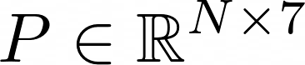
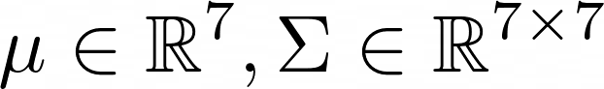
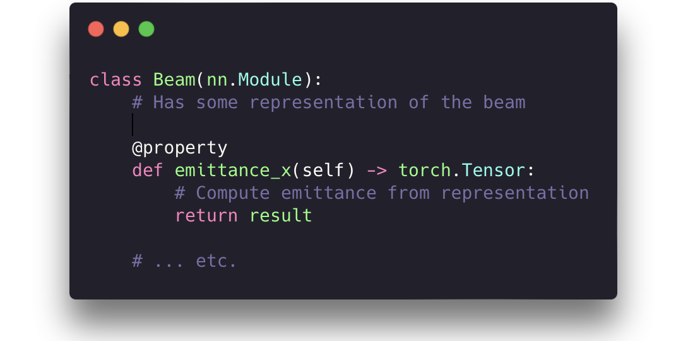
Basic Structure: Elements and Beams
Beam represents charged particle beams, with two subclasses,
Use 7-dimensional coordinate (6 phase space coordinate + 1 for affine transformation)
ParticleBeam represents a macro-particle array
ParameterBeam represents the envelope of a Gaussian beam, for fast and memory-efficient computation

Slide 7
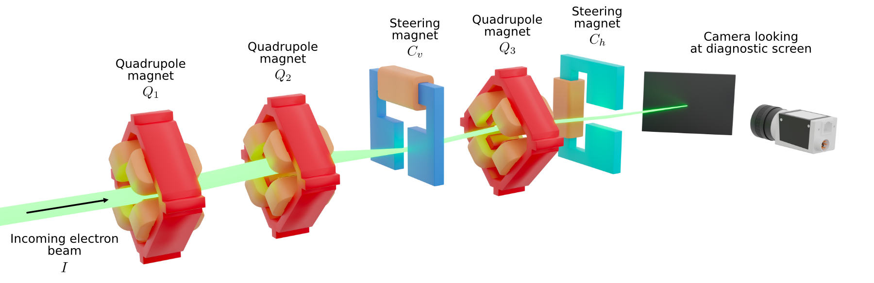
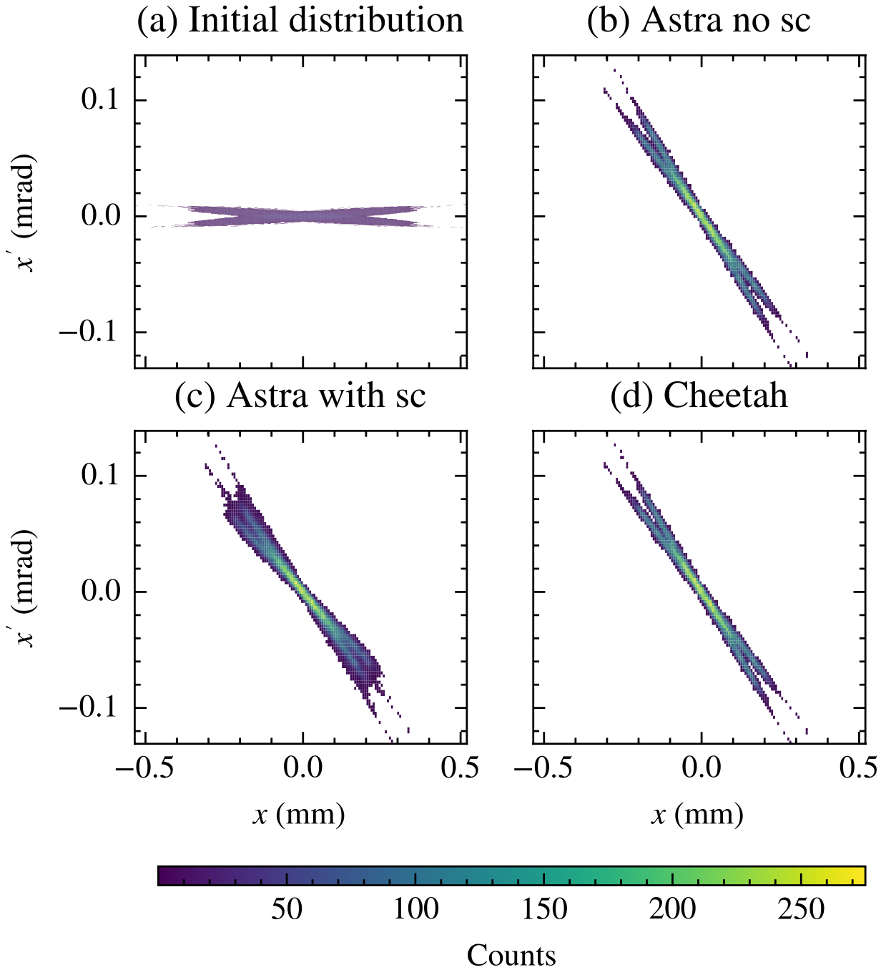
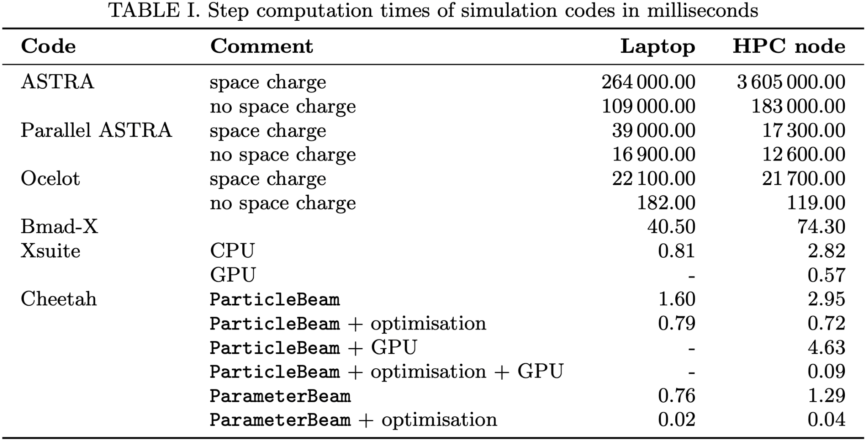
Tracking Results
Phase space through the ARES Experimental Area
Step compute times through the ARES Experimental Area

Slide 8
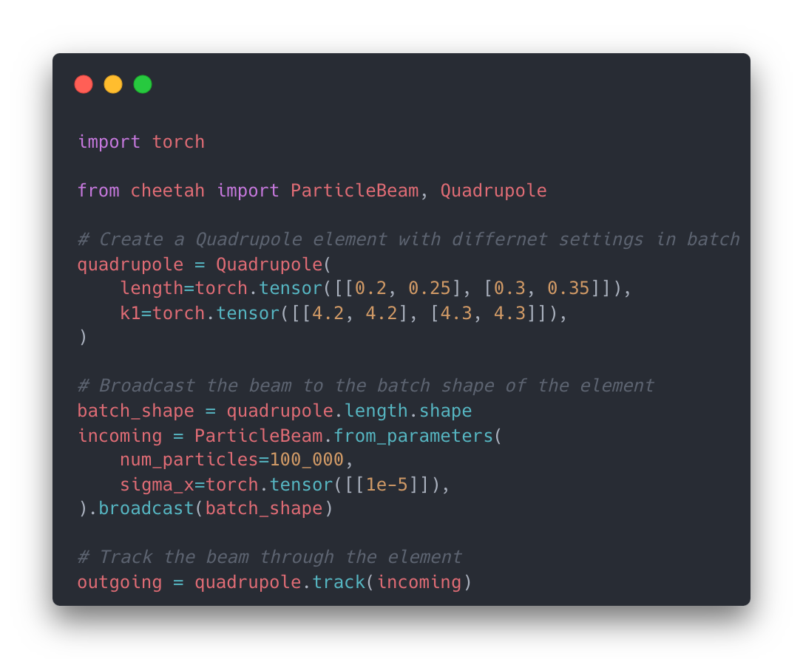
Cheetah is parallelizable
All the elements support batched execution, and the tracking can be done in parallel with
different beam distributions
different accelerator settings (magnetic strengths,...)

Slide 9
Outline
What is Cheetah?
What can you do with Cheetah?
What is the development plan?

Slide 10
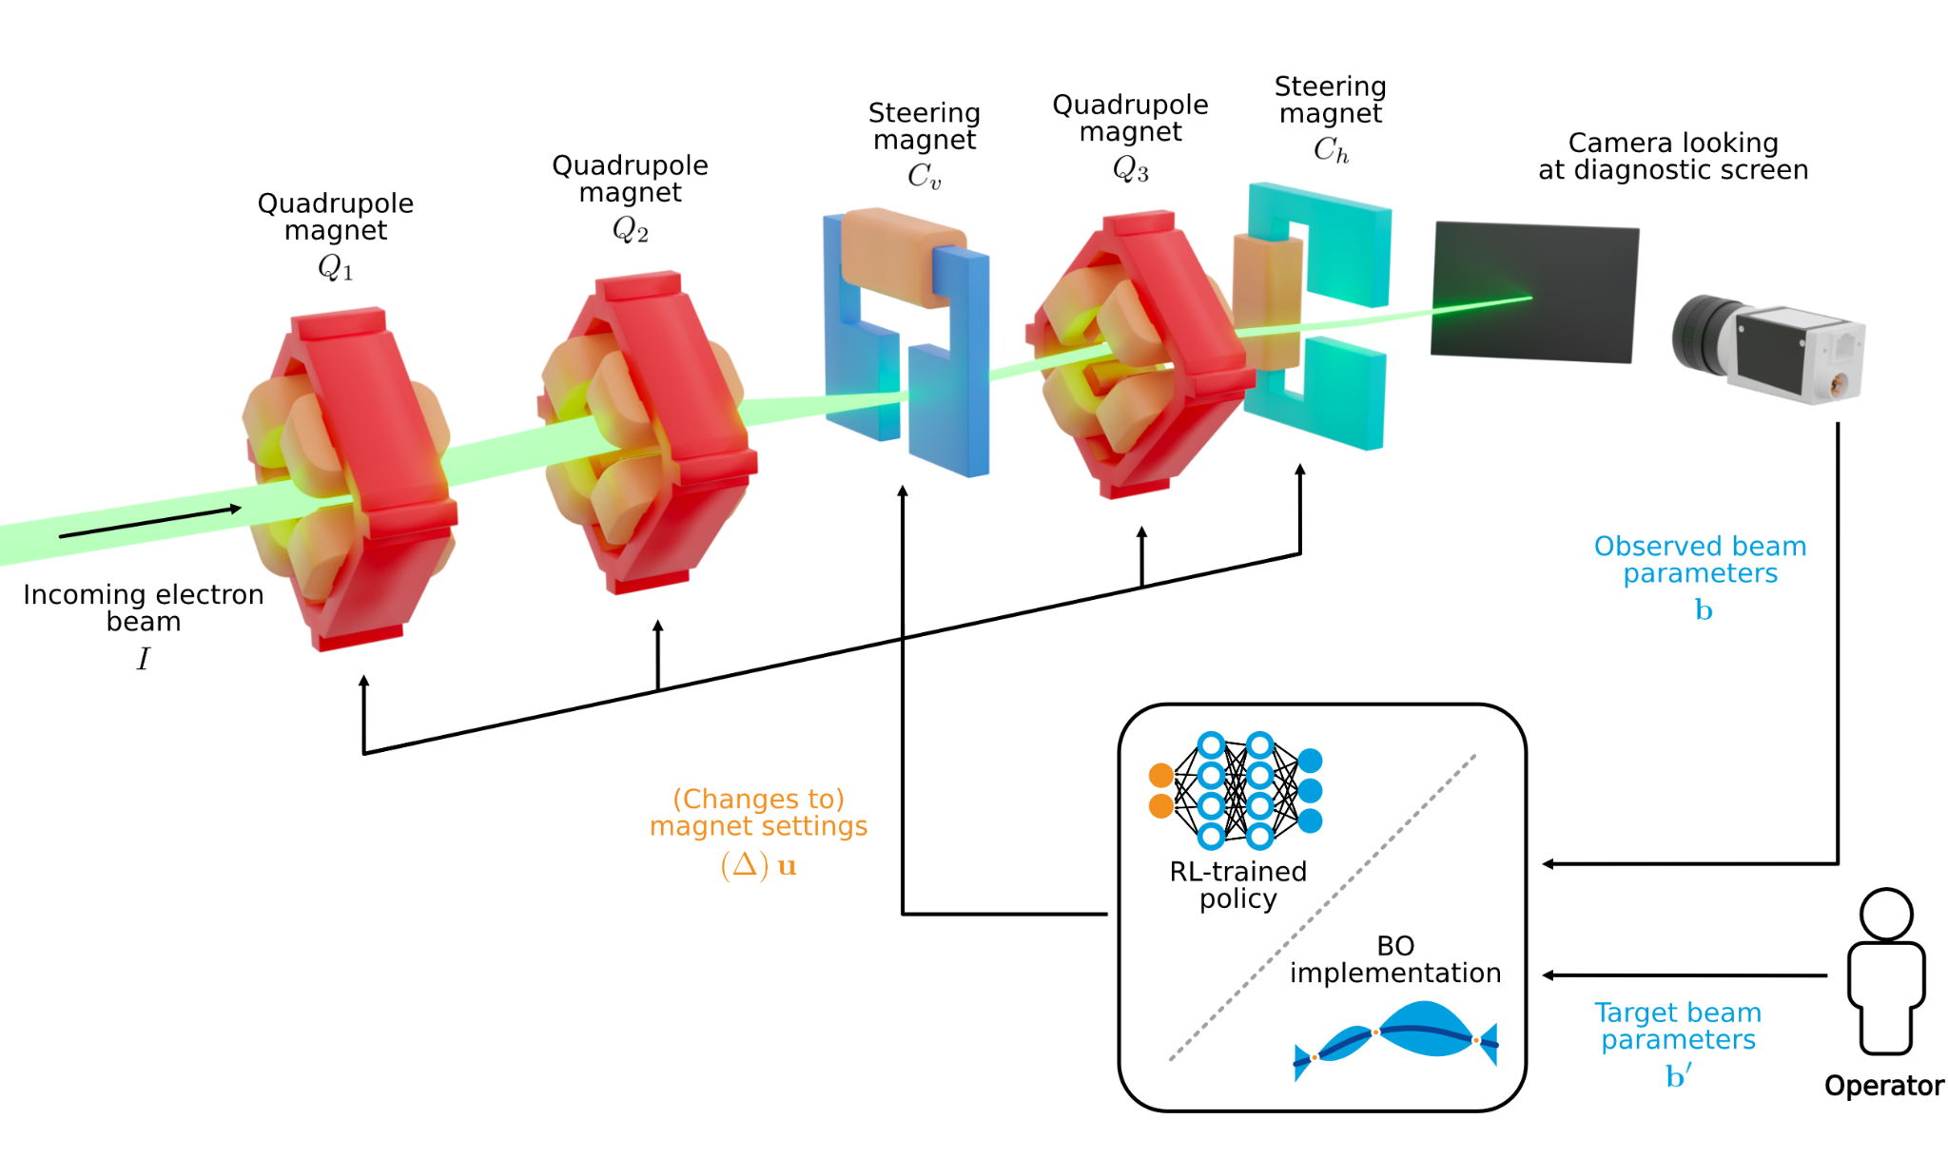

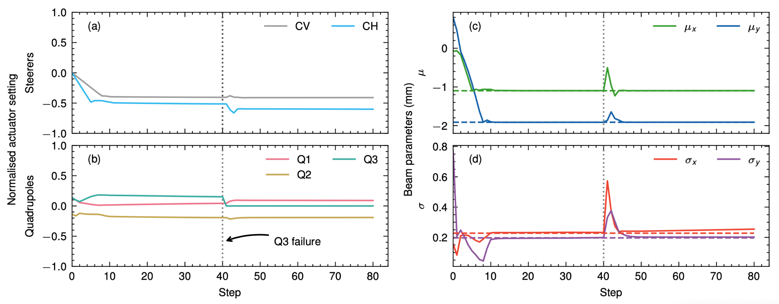
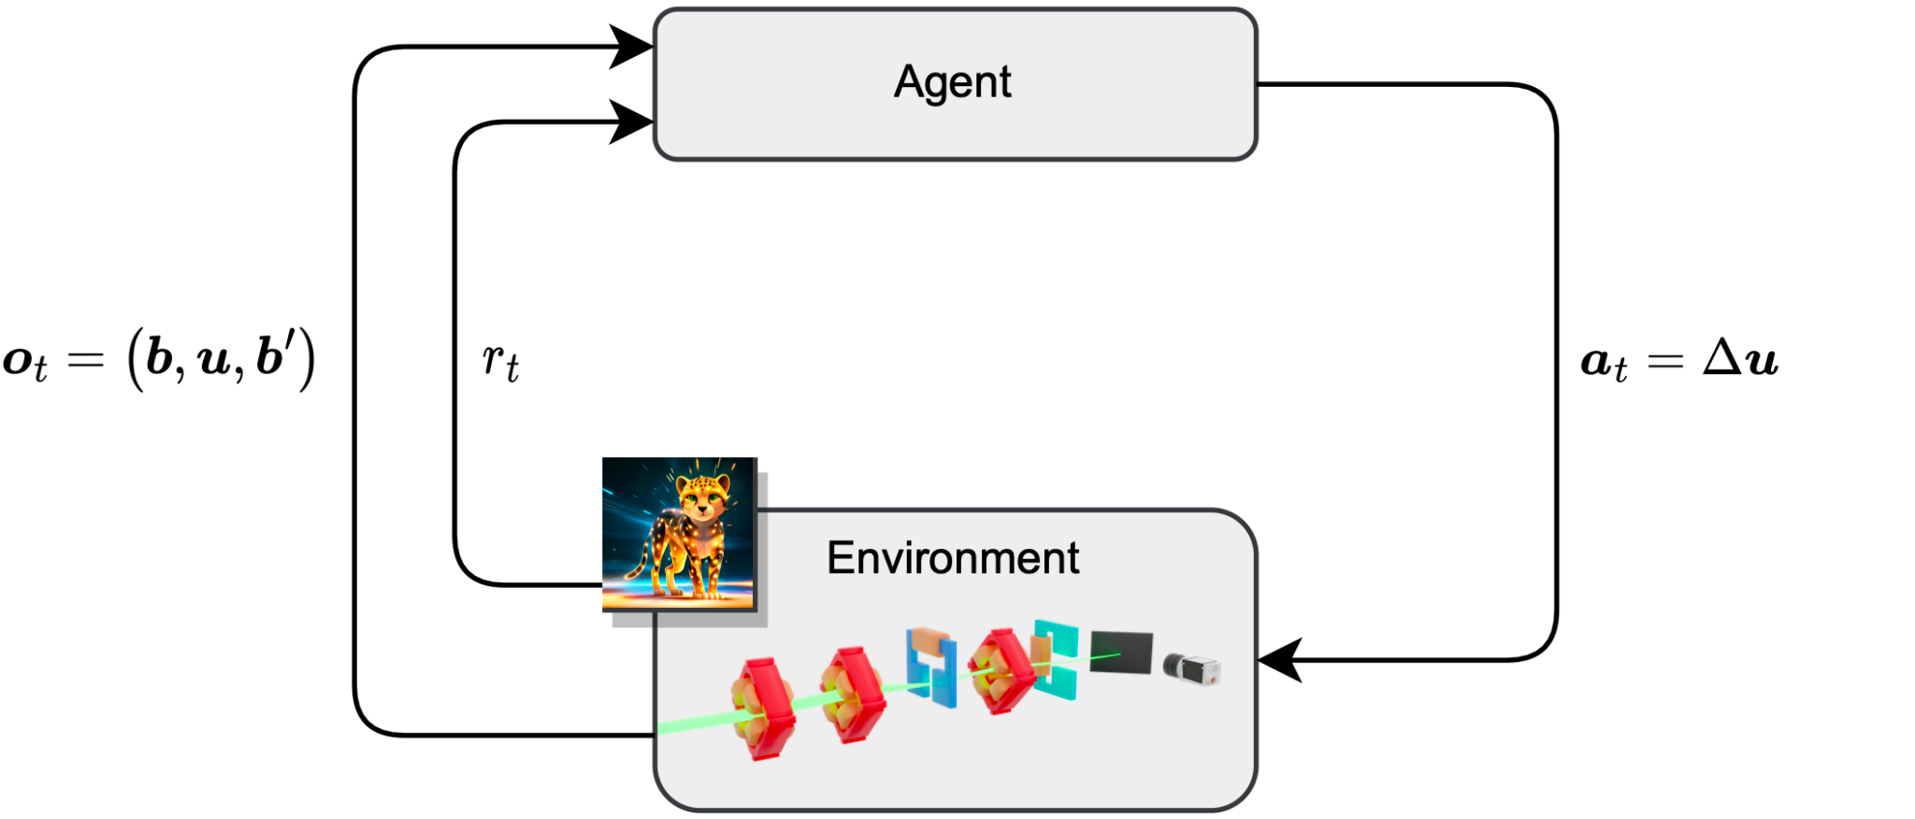
Fast Reinforcement Learning
Transverse beam tuning at ARES
Train a neural network policy to tune transverse beam parameters on a diagnostic screen using five magnets (3 quadrupoles, 2 dipoles).
Would require 3 years of beam time one the real machine, training would take 11 days with Ocelot, takes ca. 1 hour with Cheetah.
Deploy a RL-trained optimisation algorithm to the real-world with zero-shot learning thanks to domain randomisation
The trained policy outperforms other optimisation algorithms and expert human operators.
RLO in ARES EA (including feedback)
https://arxiv.org/abs/2306.03739

Slide 11
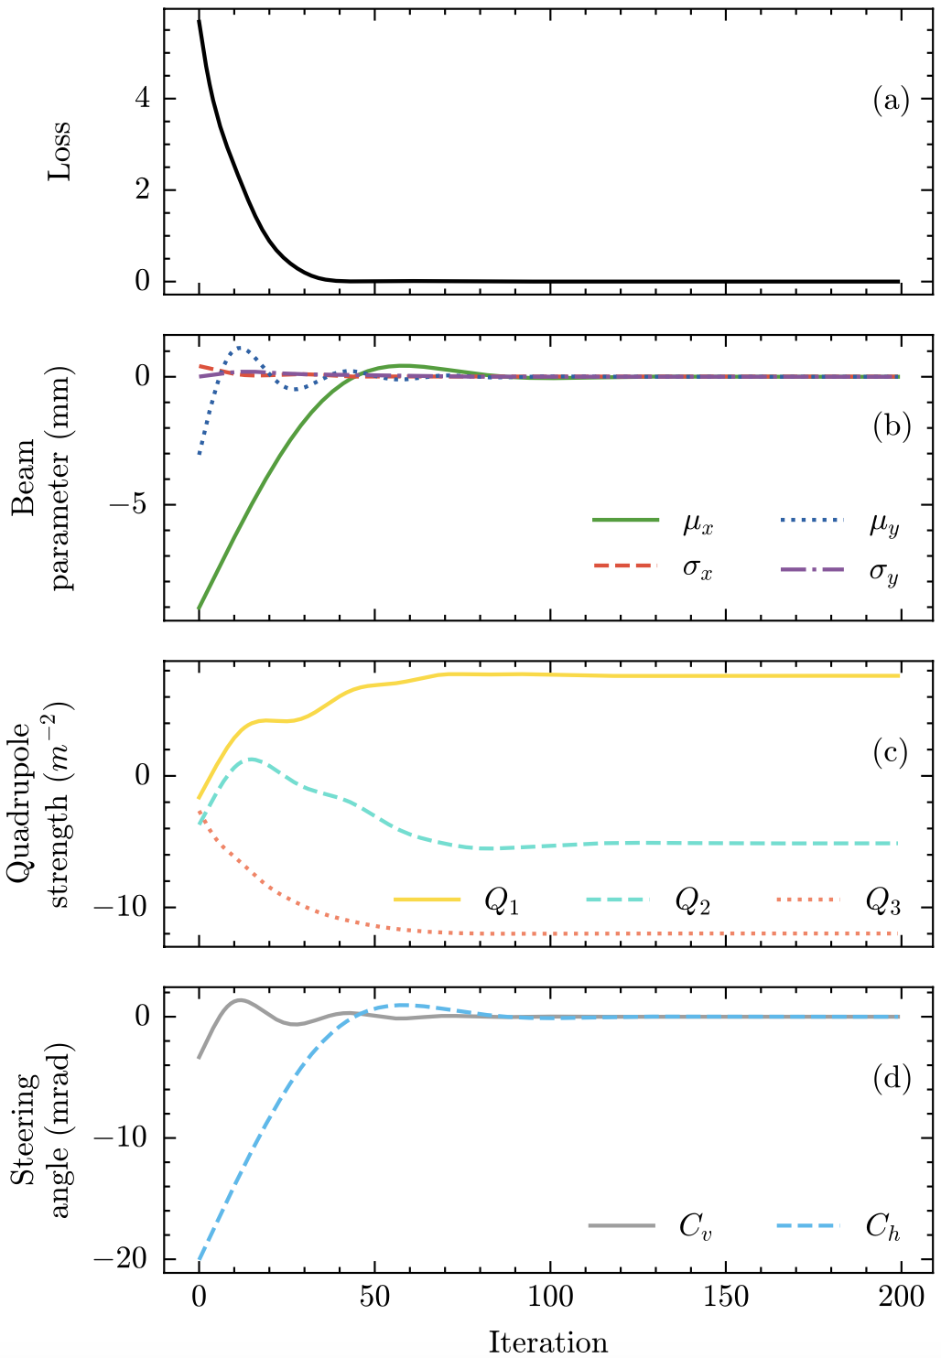
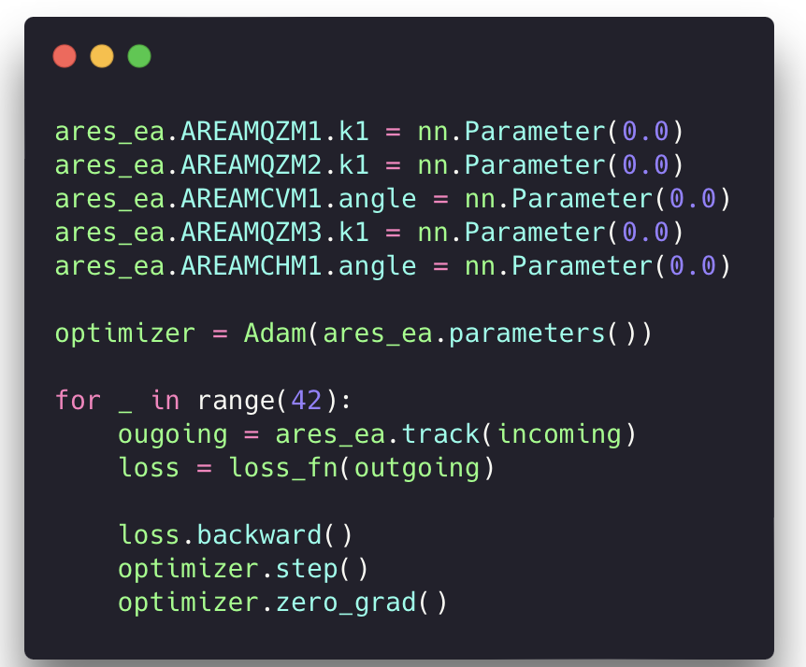
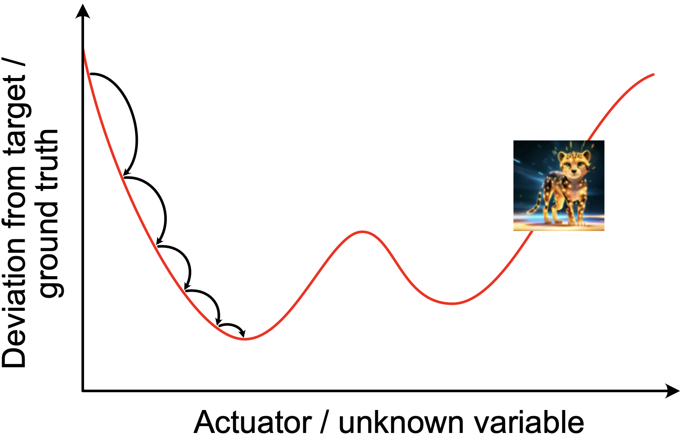
Gradient-based Tuning
Transverse beam tuning at ARES
Tune magnet settings or lattice parameters using the gradient of the beam dynamics model computed through automatic differentiation.
Seamless integration with PyTorch tools tuning neural networks.
Becomes very useful for high-dimensional tuning tasks (see neural network training).

Slide 12
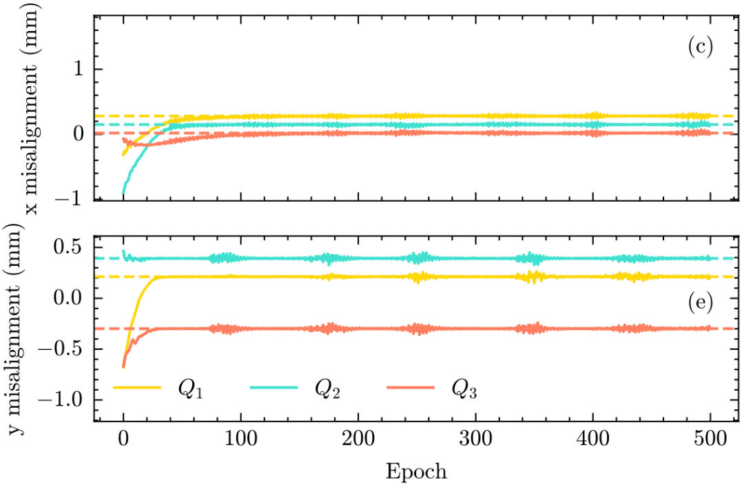
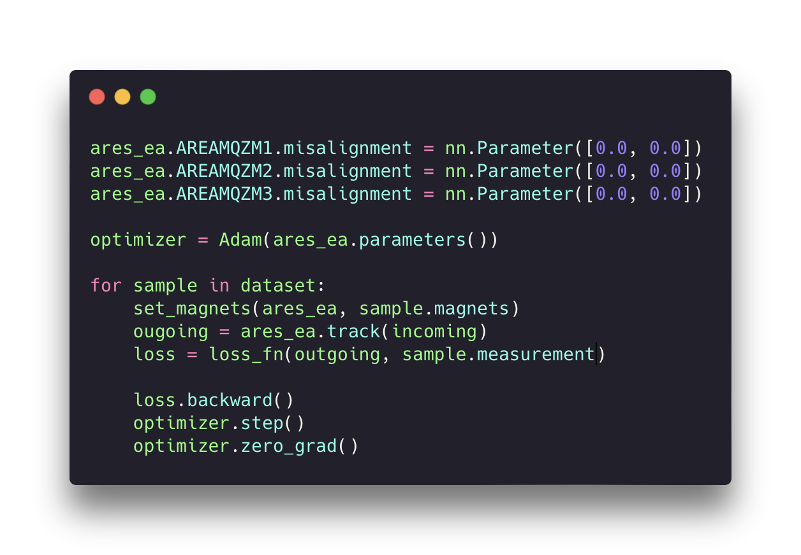
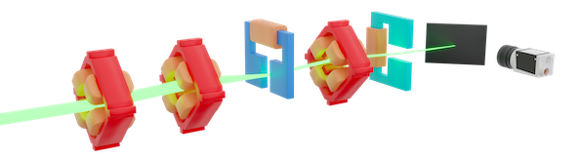
Gradient-based System Identification
Quadrupole misalignments in the ARES Experimental Area
Determine hidden system properties using the gradient of the beam dynamics model computed through automatic differentiation.
Seamless integration with PyTorch tools tuning neural networks.
Can be used in combination with gradient-based tuning.
Notes:
ARES EA example … parasitic data

Slide 13
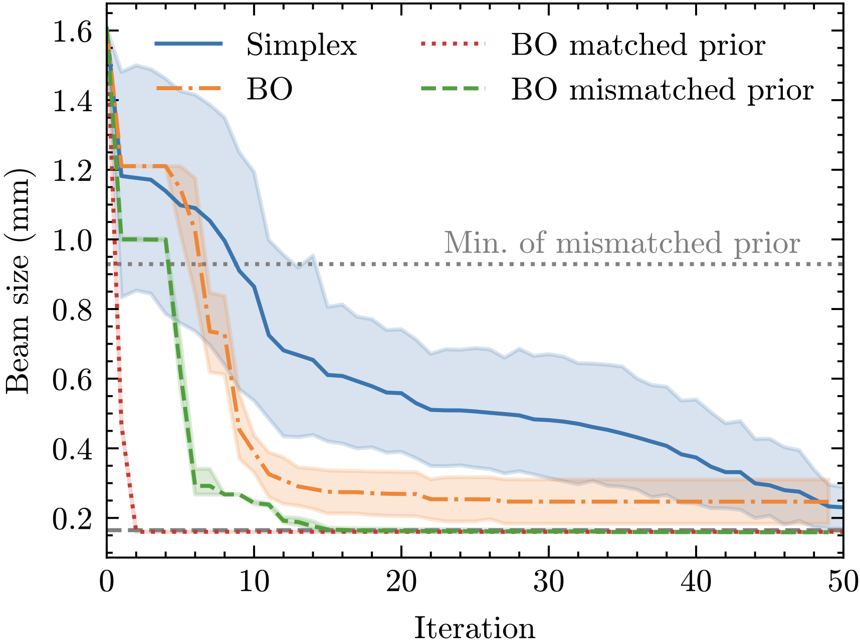
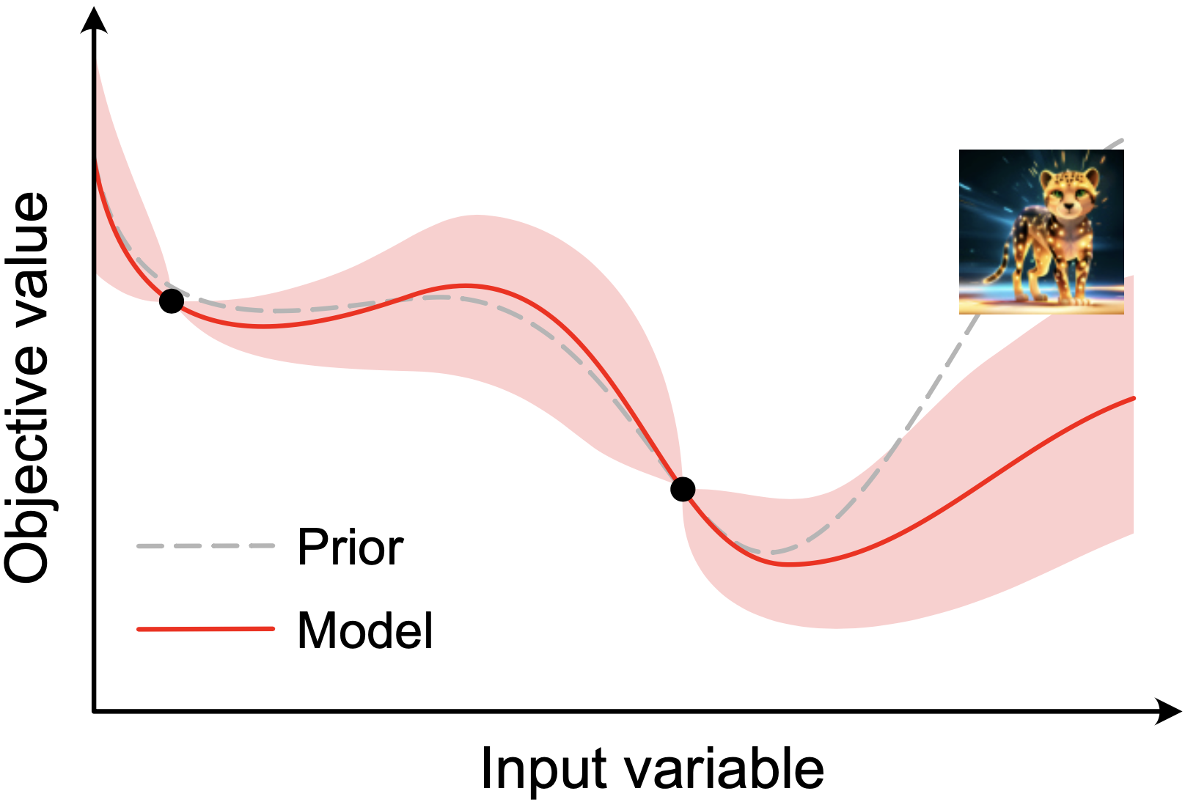
Physics-based Prior Mean for Bayesian Optimisation
Combine Cheetah with BO
A physics-informed prior can help improve the performance of BO by preventing over-exploitation.
Cheetah’s differentiability allows efficient acquisition function optimisation using gradient descent methods in modern BO packages like BoTorch.
Has well-defined behaviour and does not need data to train like neural network priors.
Can be used in combination with gradient-based system identification to overcome model inaccuracies.
FODO cell beam focusing example

Slide 14
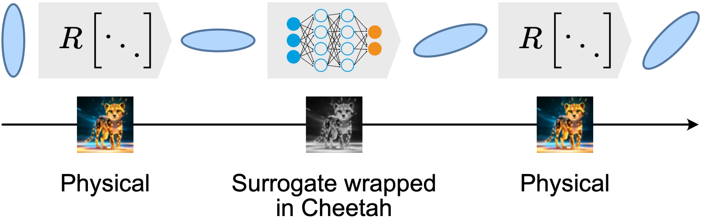
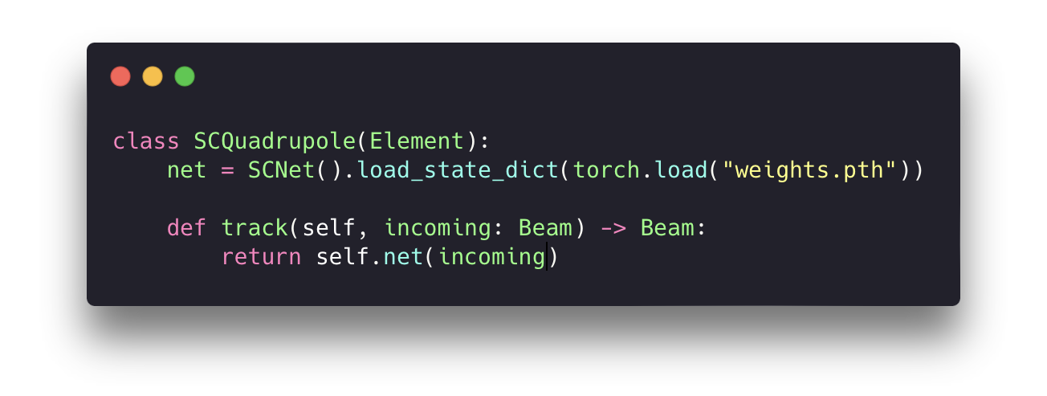
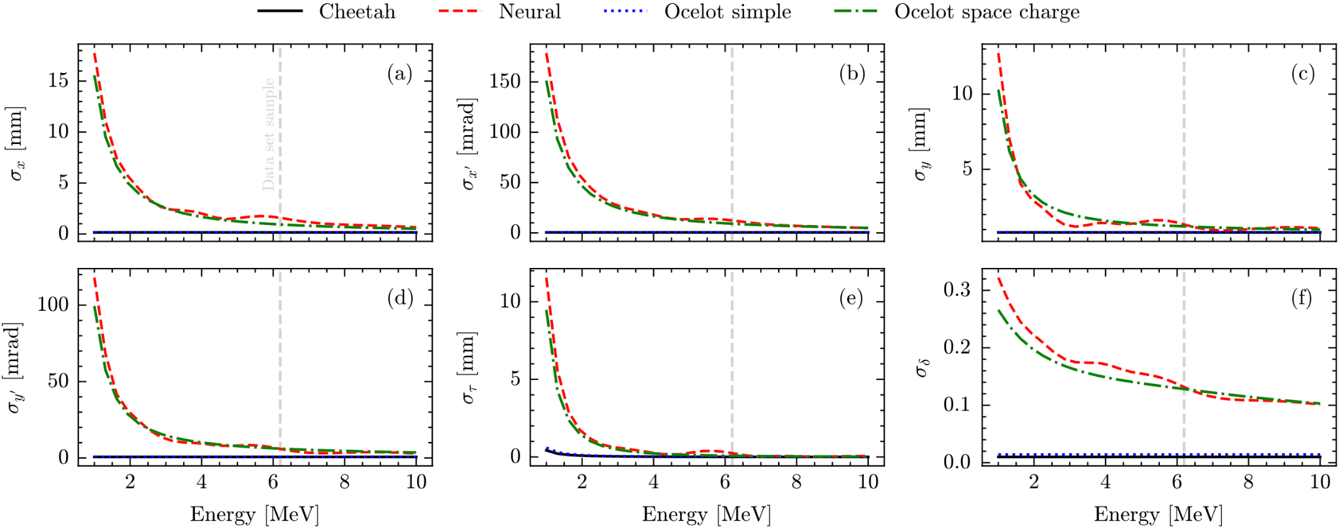
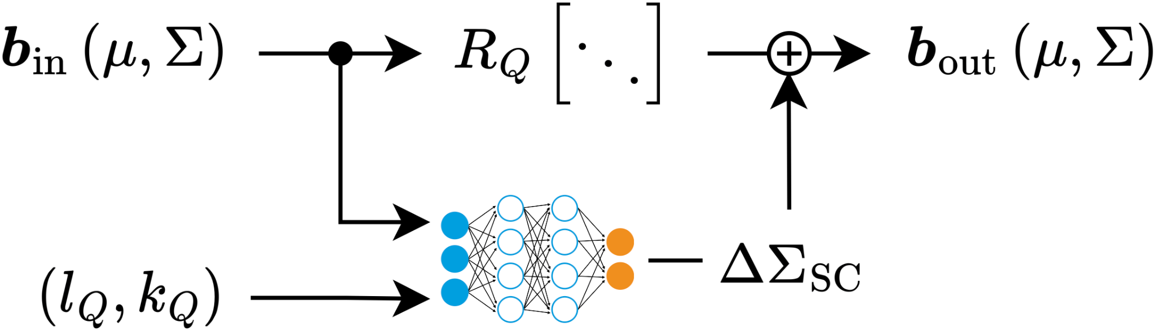
Integrate Modular Neural Network Surrogate Models
Increasing Cheetah’s fidelity with surrogate models than can be reused
Replace / augment Cheetah elements with neural network surrogates trained on high-fidelity simulations or real data.
Neural networks implemented in PyTorch are effectively native to Cheetah. Differentiability is preserved. Integration is easy.
Example: Tracking with space charge through quadrupole 3 orders of magnitude faster than Ocelot (370 microseconds).

Slide 15
Outline
What is Cheetah?
What can you do with Cheetah?
What is the development plan?

Slide 16
Space Charge Integration

Slide 17
Higher-order Tracking
Exact transfer maps for drift,
Use transfer maps from Hamiltonians and track with kick-drift-kick for other magnets (as modeled in Bmad)

